Slide 1
Professionalism in IT (COMP1635)
Active learning and Mind maps
Mrs Aditi Rawal

Slide 2
Outline
How does memory get enhanced
Note making styles
Active learning
Learning styles

Slide 3
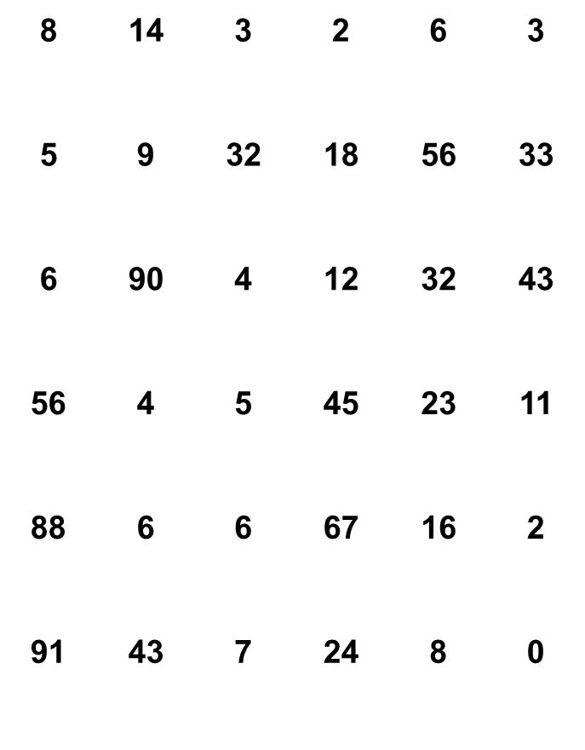
Memorise These Numbers…

Slide 4
The Man Who Could Forget Nothing
The Man Who Could Forget Nothing
Shereshevskii (1920’s)
Could memorise anything
& Repeat in any order (backwards, diagonally etc)
Even years later
Luria (1968)
But…
The Man Who Could Forget Nothing

Slide 5
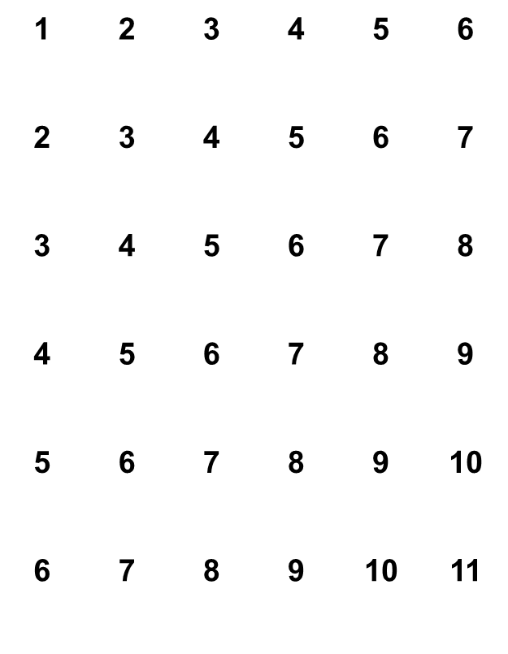
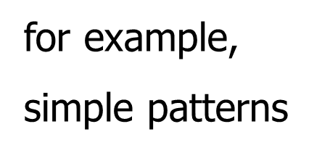
He Could Not Discern Meaning

Slide 6
Point Being…
Not enough to remember things parrot fashion
Material has to be understood
Incidentally, poor Shereshevskii
Although he made living as mnemonist
Was miserable because he could not forget anything, even things he hadn’t memorised deliberately

Slide 7
MHP (Model Human Processor) simplified representation
MHP (Model Human Processor) simplified representation
Card, Moran & Newell, 1983
perceptual
system
cognitive
system
sensory input
2
1
4
3
working memory
long term memory
5
motor
system
action

Slide 8
Memory
2 stages in memory process
Encoding
Retrieval
Retrieval enhanced by active & rich processing at the encoding stage
Depth, elaboration, distinctiveness
(Tulving, 1972; Craik & Lockhart, 1972; Anderson & Reder, 1979; Eysenck, 1979 etc etc)
i.e. you are more likely to understand & remember things if you actively process information

Slide 9
Note Making Styles
2 main techniques:
Linear (mostly text)
Pattern (visual, eg mind maps)

Slide 10
Why?
Keep records
Important points for future use
Where information comes from (references)
Help exam revision
Material well organised
More information already in memory
Help understanding
Focussing on/selecting what information is important/interesting
Organise & link information
Help creativity
Idea flow
Planning
Organising
Gets you started
Help memory
Active processing puts things in long term memory
(from Cottrell, 1999)

Slide 11
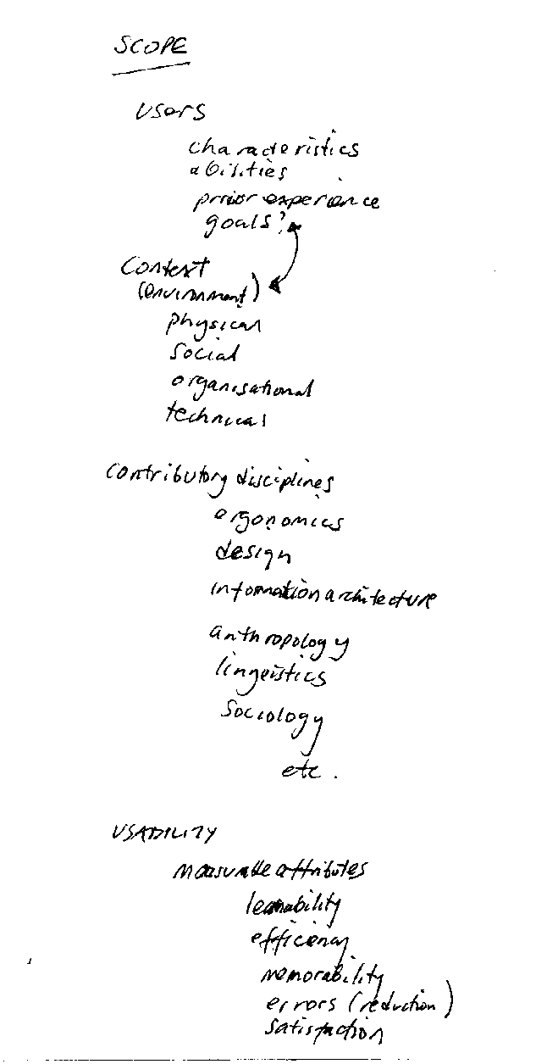
Example of Linear Notes
Source: notes made by Scane & Le Peuple for User Interface Design, in publication.

Slide 12
Characteristics of Linear Notes
Relatively time consuming to write down grammatical sentences with verbs etc
Similarly time consuming to review – large volume of text to be cognitively processed
Sets of notes visually similar – difficult to distinguish one set of notes from another and to recall
Difficult to link ideas across blocks of text

Slide 13
Characteristics of Pattern Notes e.g. Mind Maps
Contain only key words – quicker to create and review
Take up less space
Non-linear - reflecting how the brain stores information
Enhanced by colour, pictures – easier to differentiate from other sets of notes and to recall
Easier to link ideas

Slide 14
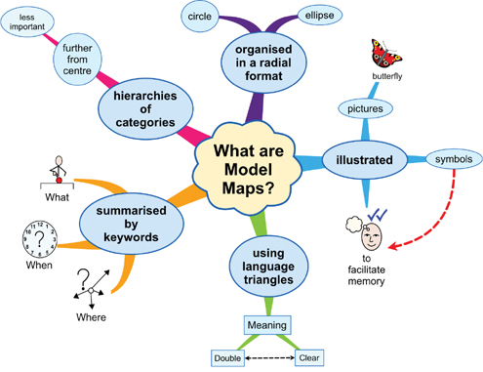
Example of a Mind Map
Source:http://www.melauspartners.com/mind-map-template-word-212.jpg

Slide 15
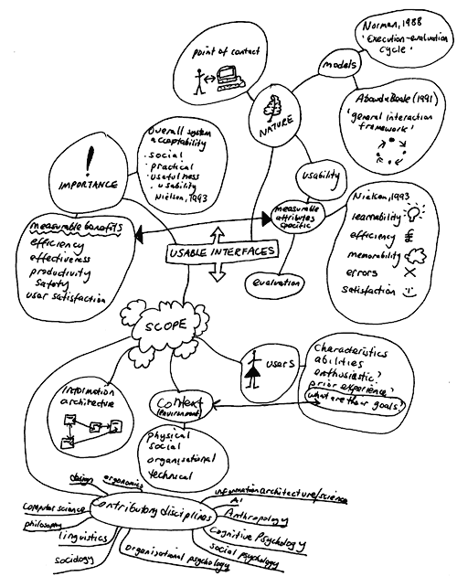
Example of Mind Map
(reproduced here in
black & white only)
Source: notes made by Scane & Le Peuple for User Interface Design, in publication.

Slide 16
Active note making
Race, (1999) makes distinction between
Note taking (passive) and note making (active)
Reflect on your own habits (do you do all, some or none of these things?)

Slide 17
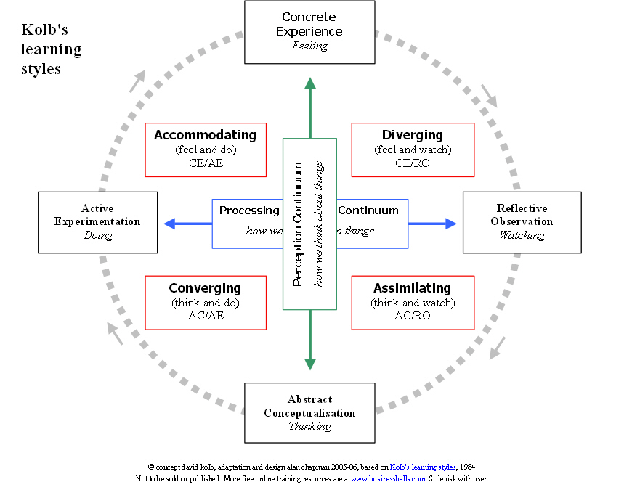
Kolb’s Learning Cycle

Slide 18
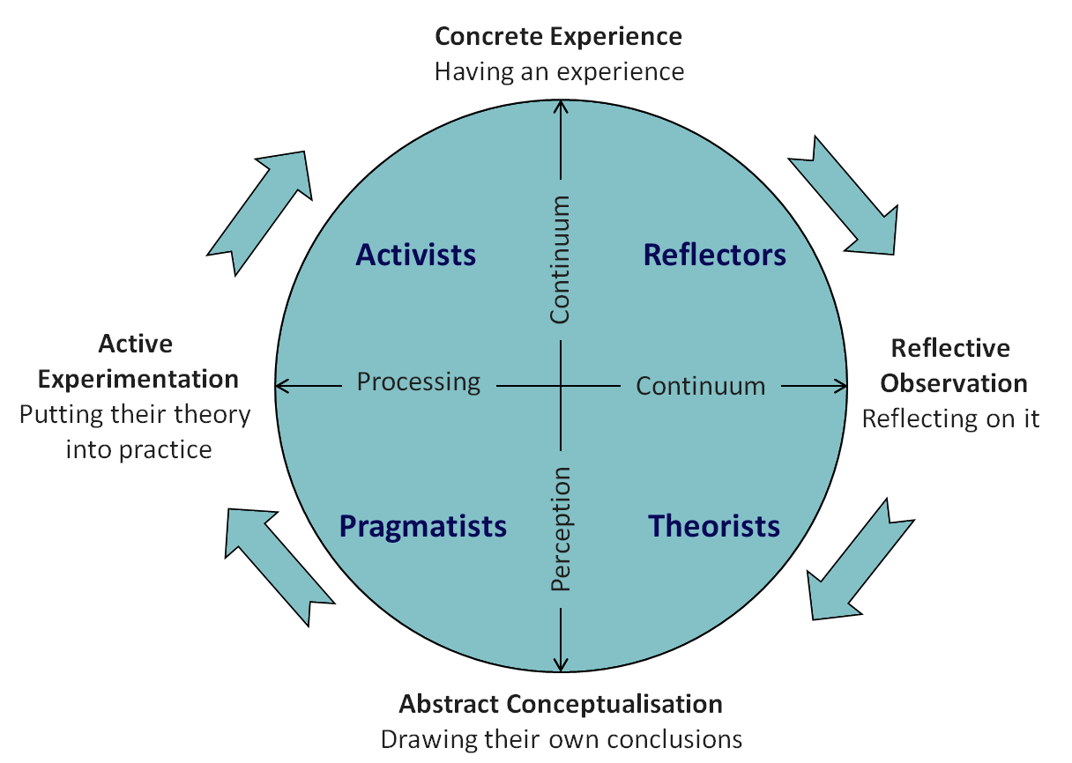
Honey and Mumford Learning Style
Source:http://www.emtrain.eu/learning-styles/images/honey_n_mumford.png

Slide 19
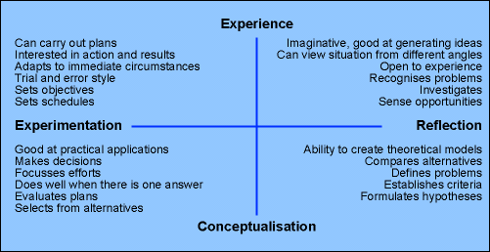
Honey and Mumford cont.
Source:http://www.dandelion-films.com/honey-and-mumford-learning-styles-questionnaire-110.gif

Slide 20
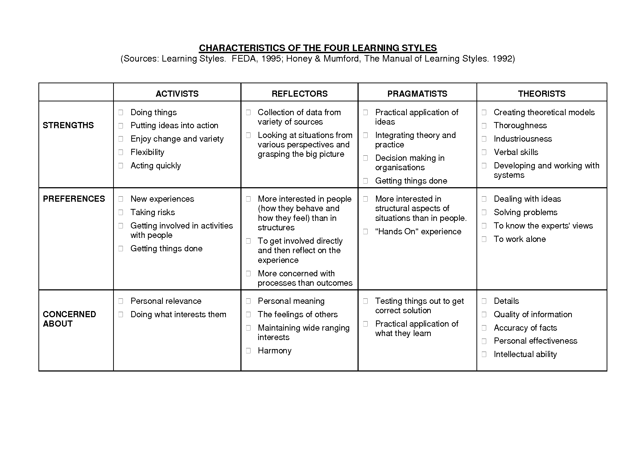

Slide 21
Summary
Memory
Short/long term; Active processing aids understanding & recall; Note taking (passive) v note making (active)
Why make notes?
Keep records; Help understanding & revision; Writing and memory aid
Note making styles
Linear or diagrammatic
Active learning
Learning styles

Slide 22
References/Bibliography/1
Anderson, J. R. & Reder, L. (1979). An elaborative processing explanation of depth of processing. In: L. S. Cermak, F. R. I. M. Craik (Eds.). Levels of Processing in Human Memory. Erlbaum.
Baddeley, A. (1996). Your Memory: a User’s Guide. Prion Books.
Buzan, T. & Buzan, B. (2000). The Mind Map Book. BBC Consumer Publishing (Books).
Card, S. K., Moran, T .P. & Newall, A. (1983) The Psychology of Human Computer Interaction, Lawrence Erlbaum Associates.
Cottrell, S. (1999). The Study Skills Handbook. Macmillan Press.
Craik, F. I. M and Lockhart, R. S. Levels of processing: a framework for memory research (1972). Journal of Verbal Learning and Verbal Behaviour, 11, 671-684.
Eysenck, M. W. (1979) Depth, elaboration and distinctiveness. In: L.S.Cermak, Craik, F. R. I. M. (Eds.) Levels of Processing in Human Memory. Erlbaum

Slide 23
References/Bibliography/2
Luria, A. R. (1968). The Mind of a Mnemonist. Basic Books.
Northedge, A. (1990). The Good Study Guide. Open University Press.
Plymouth University (Learning skills support) http://home.plymouth.ac.uk/services/help-advice/pdfs/Unit5Notetakingmaking.pdf Contains extensive information about note taking and note making techniques [last accessed 4/10/02]
Race, P. (1999). How to Get a Good Degree. Open University Press.
Tulving, E. Episodic and semantic memory (1972). In: E. Tulving and W. Donaldson, (Eds.). Organisation of memory. Academic Press.

